Slide 1
SAP NetWeaver on Azure
Notes:
Welcome to the real-world Whiteboard Design Case Study dedicated to architecting a highly available SAP NetWeaver solution on Azure

Slide 2
Abstract and learning objectives
In this whiteboard design session, you will learn how to deploy SAP on Azure infrastructure components as well as perform an SAP on Azure need assessment, take part in an SAP on Azure architecture design discussion, and respond to an RFI/RFP for SAP on Cloud opportunity.
At the end of this whiteboard design session, you will be better able to architect for SAP running on Azure infrastructure as a service components and understand proper configuration of SAP NetWeaver ASCS, database and application servers in Azure.
Notes:
Abstract and learning objectives

Slide 3
Step 1: Review the customer case study
Outcome
Analyze your customer needs.
Timeframe
30 minutes
Notes:
We’ll start by reviewing the customer case study. The intended outcome is to analyze the customer’s needs. The expected timeframe is 30 minutes.

Slide 4
Customer situation
Contoso Group is a US-based telecommunications company with headquarters in NY.
Looking to optimize its IT environment
Considering moving some of its on-premises SAP workloads to Azure
Goal is to improve agility without compromising availability and performance
Notes:
Contoso Group is a US-based telecommunications company with headquarters in New York
Looking to optimize its IT environment
Considering moving some of its on-premises SAP workloads to Azure
Goal is to improve agility without compromising availability and performance

Slide 5
Customer situation (continued)
Contoso Group maintains on-premises deployments of SAP Business Suite on Windows Server 2012 R2 with a SQL Server 2014 Database in its US-based data center.
IT challenges include:
Keeping up with the pace of business because of the time it takes to move through development and testing phases and implement new business processes into production.
Scaling production workloads to meet business needs.
Provisioning a test environment that matches production.
Providing high availability and disaster recovery capabilities for production workloads.
Notes:
Contoso Group maintains an on-premises deployments of SAP Business Suite on Windows Server 2012 R2 with a SQL Server 2014 Database in its US-based data center
IT challenges include:
Keeping up with the pace of business because of the time it takes to move through development and testing phases and implement new business processes into production
Scaling production workloads to meet business needs
Provisioning a test environment that matches production
Providing high availability and disaster recovery capabilities for production workloads

Slide 6
Customer situation (continued)
Complains that agility of the organization is hampered by time to acquire and provision project-related SAP development and testing environments
Would like to lower TCO for the SAP landscape, including the production ECC.
Concerned about managing test/dev infrastructure costs
Concerned about aging data center and hardware
Notes:
The customer complains that agility of the organization is hampered by time to acquire and provision project-related SAP development and testing environments
It is concerned about managing test/dev infrastructure costs, about aging data center and hardware and would like to lower TCO for the SAP landscape, including the production ECC

Slide 7
Customer situation (continued)
“Our existing on-premises SAP development and test environments no longer meet the agility required by the fast pace of changes in our business. In addition, our operational dependencies on SAP applications force us to seek reasonably priced availability and disaster recovery capabilities for our production SAP deployments.”
Andrew Cross, CIO, Contoso Group
Notes:
The CIO, Andrew Cross stated “Our existing on-premises SAP development and test environments no longer meet the agility required by the fast pace of changes in our business. In addition, our operational dependencies on SAP applications force us to seek reasonably priced availability and disaster recovery capabilities for our production SAP deployments.”

Slide 8
Customer needs
Reduce time to deploy new business processes to have competitive customer offers.
Reduce time required to provision development and test environments.
Lower costs incurred by the development, test, and production environments.
Identify the monthly infrastructure cost for operating the new solution.
Notes:
Customer needs include:
Reducing time to deploy new business processes to deliver competitive customer offers
Reducing time required to provision development and test environments
Lowering costs incurred by the development, test, and production environments
Identifying the monthly infrastructure cost for operating the new solution

Slide 9
Customer objections
If I have already paid for my hardware to host my dev/test environment, how am I getting any cost savings by moving it to Azure? How much more is your cloud solution costing me?
What if I need my cloud resources to access on-premises resources?
Will Azure meet our security and compliance requirements?
Do I have to pay for resources when they are stopped?
For my dev environment, can I automate stopping VMs during idle times?
Notes:
Customer raised some concerns and objections:
If I have already paid for my hardware to host my dev/test environment, how am I getting any cost savings by moving it to Azure? How much more is your cloud solution costing me?
What if I need my cloud resources to access on-premises resources?
Will Azure meet our security and compliance requirements?
Do I have to pay for resources when they are stopped?
For my dev environment, can I automate stopping VMs during idle times?

Slide 10
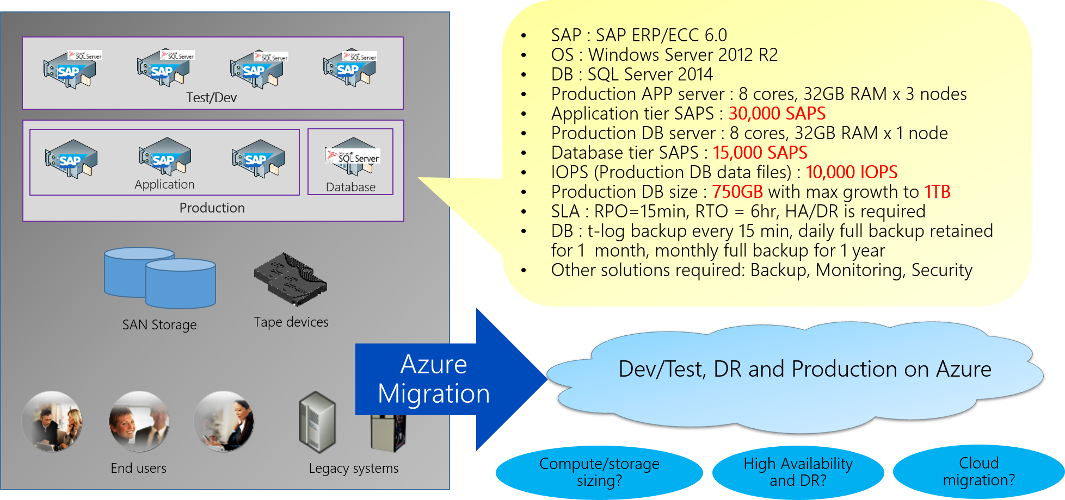
Customer environment
Notes:
To summarize, the technical requirements include the following:
SAP ECC NetWeaver (app server) is the application tier
SQL Server 2014 is the data tier
Application tier requires 30,000 SAPS
Database tier needs 15,000 SAPS
SLA: RPO=15 min, RTO=6 hour

Slide 11
Design Principles
Sizing (Compute, Storage)
High Availability
Backup
Disaster Recovery

Slide 12
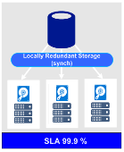
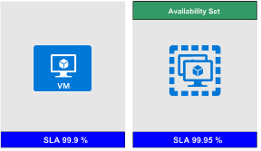
SAP VM & Storage Sizing Principles
Know # of SAPS for SAP application and database tiers
Know system activity period, use snoozing, Azure automation to shutdown (i.e. sandbox 10x5, not 24x7)
For SAP APPL servers, use a few smaller VM vs one large VM (redundant nodes).
Ensure the selected VM supports the IOPS & throughput requirements of the database server.
Choose standard or premium storage Managed Disks based on IOPS and disk throughput requirements.
SAP application servers usually deployed on standard storage; but, can be deployed on small premium storage (P4, P6) if using a single server and to benefit from single instance SLA.
Use premium storage for SAP databases (both database files and log file(s)).
For database servers use Windows storage spaces or LINUX-LVM to stripe (glue) disks and aggregate IOPS, throughput and storage capacity

Slide 13
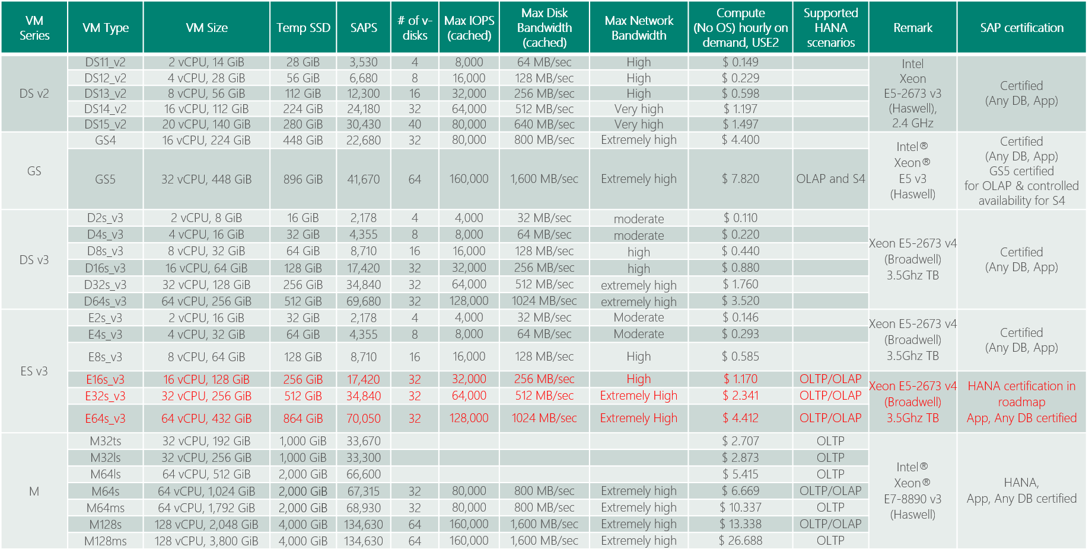
(SAPS) Azure VM Options for SAP Applications
SAP Note 1928533 and https://docs.microsoft.com/en-us/azure/virtual-machines/windows/sizes-memory
Red: certification in roadmap
Notes:
Double clicking Azure VMs /- here’s the list of SAPS and memory size / of each Azure VM type. D v2 and G are certified as of today / and E v3 and M Series release and certification / are coming soon / with official numbers of SAPS. Customer should feel very free to use / E v3 and M / for their non-prod even without certification / because it works just fine.
Based on total # of SAPS for Any DB, and memory size and HANA scenario – OLAP or OLTP, you can pick VM type for both database server and application server.
https://docs.microsoft.com/en-us/azure/virtual-machines/windows/sizes-memory
https://azure.microsoft.com/en-us/blog/introducing-the-new-dv3-and-ev3-vm-sizes/

Slide 14

Premium Storage KPIs (Cost differ by region)
Premium Storage Disk Type | P4 | P6 | P10 | P15 | P20 | P30 | P40 | P50
Disk size | 32 GB | 64 GB | 128 GB | 256 GB | 512 GB | 1024 GB (1 TB) | 2048 GB (2 TB) | 4096 GB (4 TB)
IOPS per disk | 120 | 240 | 500 | 1100 | 2,300 | 5,000 | 7,500 | 7,500
Throughput per disk | 25 MB/s | 50 MB/s | 100 MB/s | 125 MB/s | 150 MB/s | 200 MB/s | 250 MB/s | 250 MB/s
Consistent low latency SSD with predictable throughput
For high-performance IO-intensive DB workloads
Single digit ms latencies
Supports up to 4 TB blob/disk size
Stripe up to 64 disks for a total of 256 TB
Disk performance is dependent on the disk size, with up to 7,500 IOPS per disk
Pay for what you provision
Check Azure VMs for maximum IOPS
* Stripe Premium Storage Disks to aggregate
IOPS, Throughput and Storage Capacity

Slide 15
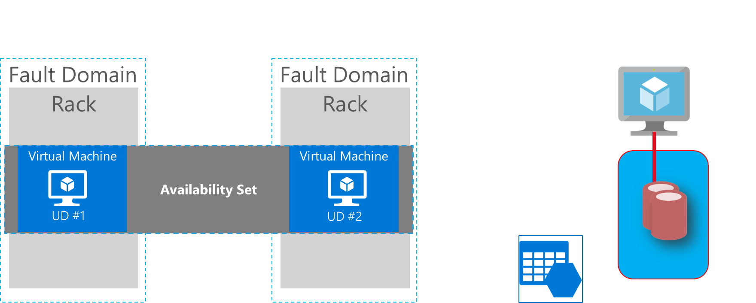
Common scenarios
Notes:
To produce the design, use the following sequence of steps.

Slide 16
SAP HA Architecture SAP NetWeaver ABAP / Java 7.00 (and higher) – Windows & Linux
(*) ASCS : ABAP SAP Central Services – part of SAP application servers running message/enqueue service, which is a single point of failure (SPOF)
SAP Instances in 4 Layers:
One or more Application Server Instances (Redundant Components)
One ASCS Instance (SPOF)
One File Share Instance (SPOF)
One Database Instance (SPOF)
AP
AP
…..
AP
(A)SCS
File Share
DBMS

Slide 17

Azure ILB
(A)SCS IP
Azure ILB
SQL Server IP
Azure AS
Azure AS
Azure AS
SAP ASCS
SAP <SID>
DBMS
AS
AS
(A)SCS
SQL
PRIMARY
SECONDARY
ERS
ERS
Availability Set
Availability Set
Windows Server 2016 Failover Cluster
\\<SAPGLOBALHost>\sapmnt\<SID>\SYS\...
SQL AlwaysOn Availability Group
SOFS
Availability Set
Windows Server 2016 Scale Out Files Server (SOFS) + Storage Spaces Direct (S2D)

Slide 18
Enterprise Backup Solutions for LOB applications/SAP on Azure
Fully online backup of SQL Server databases, Files and OS states while system overhead is minimum
Backup to Azure Blob Storage (= Azure Backup Vault)
Point-in-time restore
Saving backup storage (= Incremental Backup)
Centralized console for monitoring and alert capabilities
1
2
3
4
5

Slide 19
SAP on Azure Backup Solutions
 | Standard DB backup (e.g. SQL, Oracle, HANA) |  | Azure Backup Server (=SCDPM on Azure) | 3rd party solutions (e.g. Commvault, NetBackup) | Azure IaaS VM Backup | HANA on Azure Large Instances Storage Snapshot
Backup type | Database |  | Network/Agent | Network/Agent | Snapshot | Storage level snapshot
Backup target | DBs within Azure VMs |  | SQL Server DBs, Files and OS States (Windows) within Azure VMs (link) | SQL Server/Oracle/HANA, Files and OS States (Windows, Linux) within Azure VMs | Azure VMs (Windows, Linux) running SQL Server (link) | HANA database volume, HANA log volume, boot volume (link)
Linux (Guest OS) support | - |  | No | Yes | Yes | Yes
SQL Server database backup capability | Transaction log (every minute), differential, full |  | Differential every 15 minutes and full (express) | Yes | Up to 3 times per day | -
Oracle database backup | No |  | No | Yes | File consistent backup with RMAN | -
Compression | Supported |  | Supported (storage sizing : link) | Supported | None | -
Backup servers running on | DB Server |  | Microsoft Azure Backup Server (on VM) (installation kits downloadable from Azure Portal) (VM sizing : link) | Backup Server (on VM) | None (Backup as a Service) | -
Agent software required | No |  | Agent in backup target VMs and Azure Backup Agent in Azure Backup Server VMs | Yes | No (* Only Azure VM Agent) | No
Network bandwidth required | Yes but controllable |  |  |  | None | None
Short term retention | Yes (on local storage) |  |  |  | None | Yes (on local NFS storage)
Long term retention | Possible |  |  |  |  | Up to 255 snapshots per volume (or transfer to Blob Storage)
Point-in-time recovery | Possible
Recovery speed | Depend on I/O speed of underneath Blob storage or Backup Vault |  |  |  |  | Fast
Monitoring/alerting console | Database console | Azure Backup Server Console |  | Backup Server Console | Azure Management Portal | Script
Reporting | Database console | System Center Service Manager |  | Backup Server Reporting | None | Script
Licensing | Built-in | Pay-per-use on Azure (link) |  | Check vendor | Pay-per-use on Azure (link) | Built-in

Slide 20
Disaster Recovery Solutions for LOB applications/SAP on Azure
Business requirements
Minimum data loss in case of a disaster
Failover complete within hours including SAP application layer
Clear failover process
Failover transparent to users and sub systems
Minimum costs for DR
IT requirements
Production environment is on virtualization, bare metal or cloud
Minimum overhead on Production systems and network
Retire traditional SAN/Tape-based solutions
1
2
Database Replication (e.g. SQL Server AlwaysOn)
File Replication (e.g. File Copy)
VM Replication (Azure Site Recovery)
(*) Note : ASR doesn’t support replication from shared cluster disk or Win 2016 SOFS
Notes:
https://docs.microsoft.com/en-us/azure/site-recovery/site-recovery-support-matrix-to-azure

Slide 21
Step 2: Design the solution
Outcome
Design a solution and prepare to present the solution to the target customer audience in a 15-minute chalk-talk format.
Timeframe
60 minutes
Business needs (10 minutes) | Respond to questions outlined in your guide and list the answers on a flipchart.
Design (35 minutes) | Design a solution for as many of the stated requirements as time allows. Show the solution on a flipchart.
Prepare (15 minutes) | Identify any customer needs that are not addressed with the proposed solution. Identify the benefits of your solution. Determine how you will respond to the customer’s objections. Prepare for a 10-minute presentation to the customer.
Notes:
Now it’s time to design the solution and prepare to present it to the target customer audience in a 15-minute chalk-talk format. The expected timeframe is 60 minutes.

Slide 22
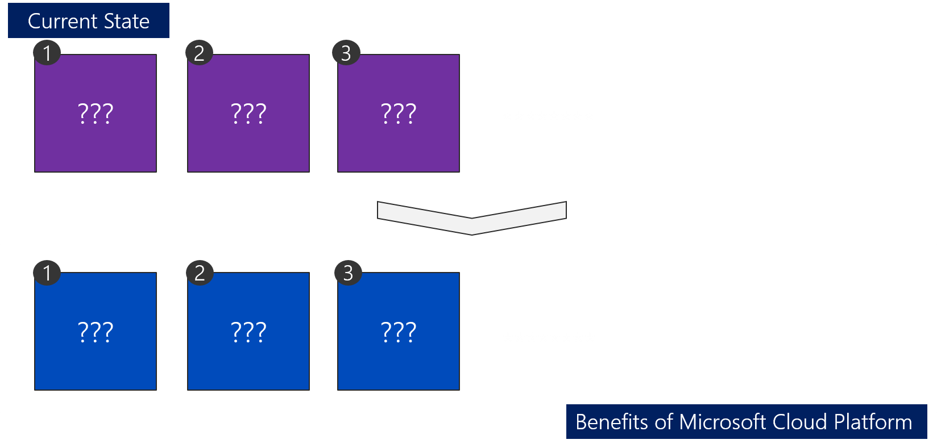
Contoso current SAP state/benefits of migration to Azure
Notes:
Consider the current state of Contoso’s SAP environment and benefits of migrating it to Azure.

Slide 23
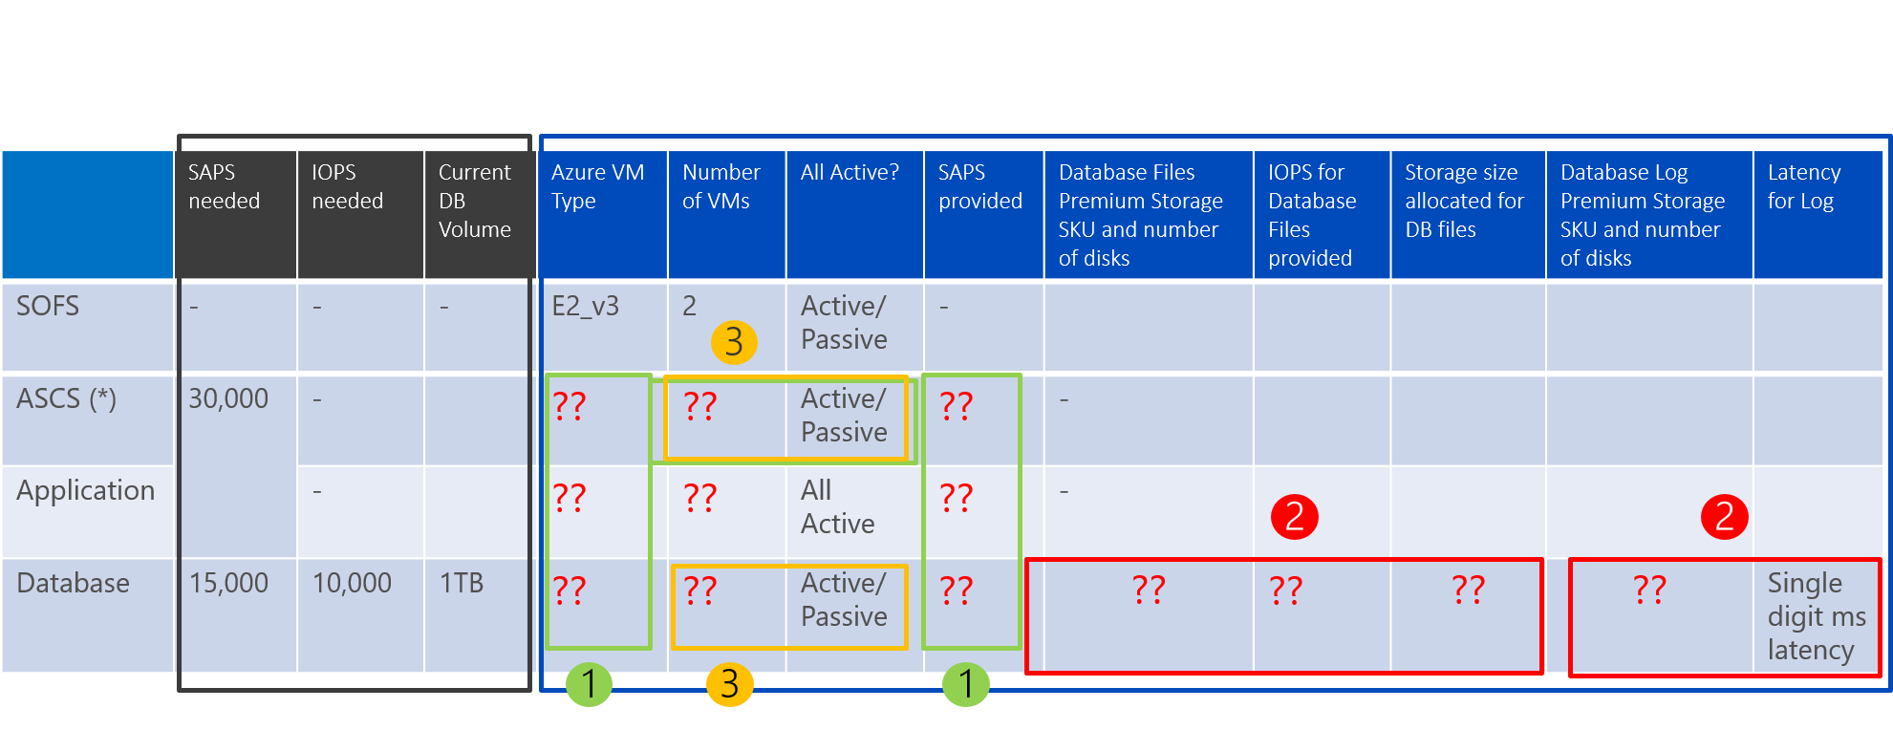
How to size SAP on Azure VM
1
Choose VM type for SAP ASCS, Application and Database, based on SAPS required
2
Decide Premium Storage type and number of disks for SAP database file space, based on IOPS/throughput
3
Set up high availability solution for SAP ASCS and Database, based on SLA
Notes:
In your sizing exercise, use the table presented on the current slide, and note the sequence of steps you should follow when sizing individual tiers of your solution.

Slide 24
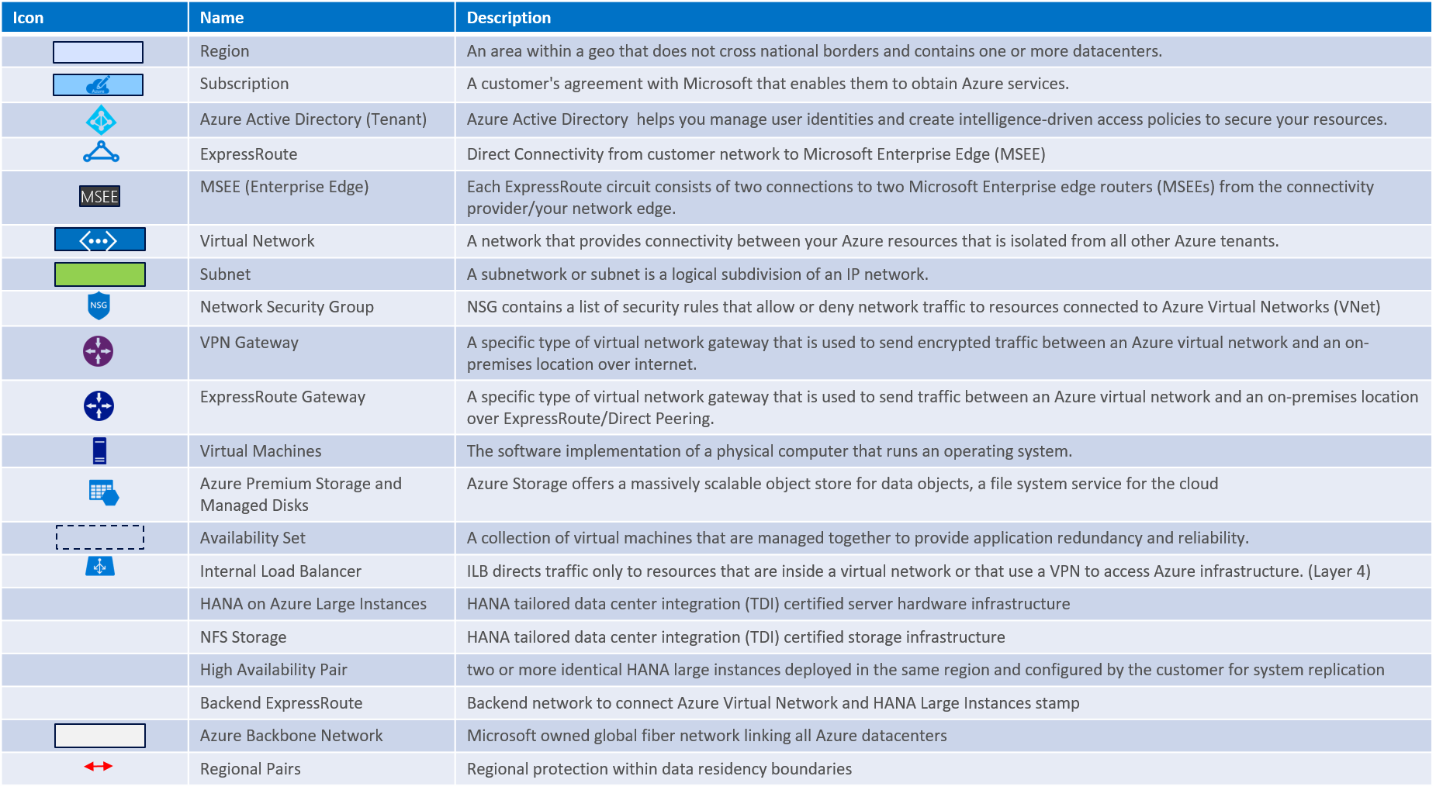
Baseline knowledge for SAP as a service on Azure

Slide 25
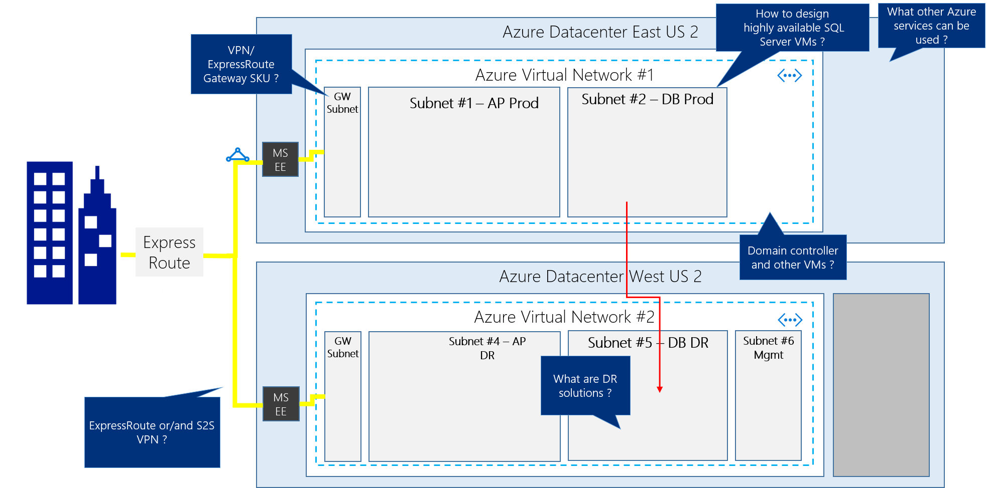
SAP business suite, NetWeaver – with HA and DR
Notes:
Your HA/DR design should eliminate all SPOFs and include cross-Azure region resiliency.

Slide 26
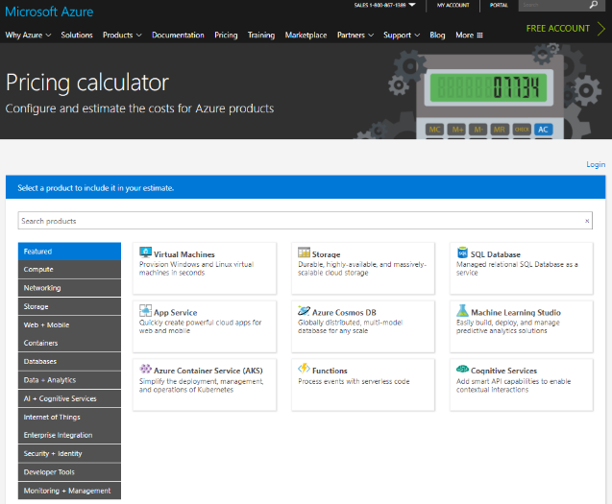
Online Azure pricing calculator
https://azure.microsoft.com/en-us/pricing/calculator/
Notes:
To estimate the cost of your solution, use Azure Pricing Calculator.

Slide 27
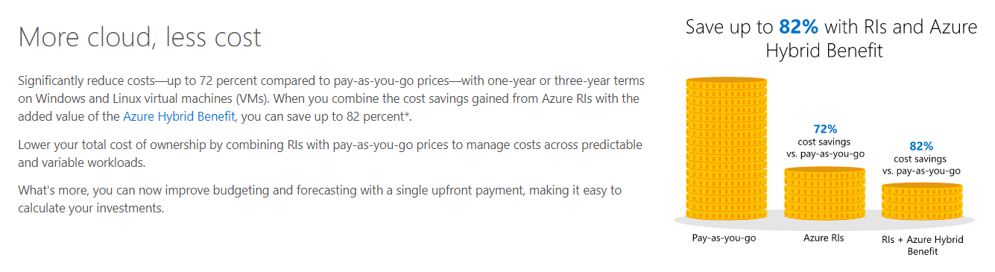
Azure reserved VM instances (RI) and Azure hybrid benefit (AHUB)
https://azure.microsoft.com/en-us/pricing/reserved-vm-instances/
https://azure.microsoft.com/en-us/pricing/hybrid-benefit/
Notes:
Take into account the reduced pricing offered by AHUB and reserved instances.

Slide 28
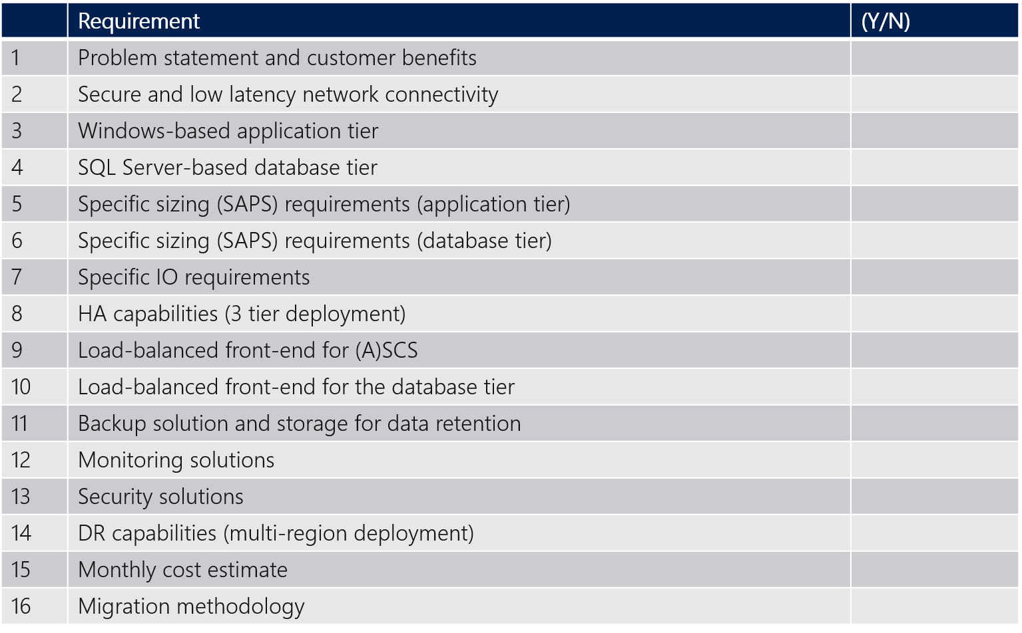
Requirements
Notes:
To produce the design, use the following sequence of steps.

Slide 29


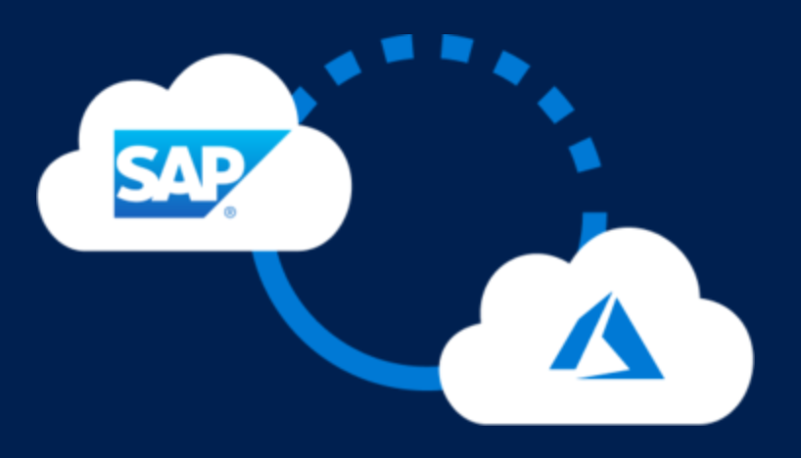



Common scenarios
Azure Infrastructure as a Service (IaaS)
SAP on Azure
Virtual machines
Virtual networks
VPN gateway
Hybrid connectivity
Load balancers
Storage
https://aka.ms/sapazure
Notes:
To produce the design, use the following sequence of steps.

Slide 30
Step 3: Present the solution
Outcome
Present a solution to the target customer in a 15-minute chalk-talk format.
Timeframe
30 minutes (15 minutes for each team to present and receive feedback)
Directions
Pair with another table.
One table is the Microsoft team and the other table is the customer.
The Microsoft team presents their proposed solution to the customer.
The customer asks one of the objections from the list of objections in the case study.
The Microsoft team responds to the objection.
The customer team gives feedback to the Microsoft team.
Tables switch roles and repeat Steps 2 through 6.
Notes:
Now it’s time to present the solution to the target customer audience in a 15-minute chalk-talk format. The expected timeframe is 30 minutes.
To present the solution, use the following sequence of steps:
Pair with another table.
One table is the Microsoft team and the other table is the customer.
The Microsoft team presents its proposed solution to the customer.
The customer asks one of the objections from the list of objections.
The Microsoft team responds to the objection.
The customer team gives feedback to the Microsoft team.
Tables switch roles and repeat Steps 2 through 6.

Slide 31
Wrap-up
Outcome
Identify the preferred solution for the case study.
Identify solutions designed by other teams.
Timeframe
30 minutes
Notes:
To wrap-up the case study, identify the preferred solution for the case study and compare it with solutions designed by other teams. The expected timeframe for completing this step is 30 minutes.

Slide 32




Go Dos and Resources
Learn
SAP on Azure Website
SAP on MS Platform blog
SAP on Azure – SAP Community Wiki
SAP HANA/NetWeaver on Azure Documentation
HANA on Azure Large Instances Architecture
SAP on Azure reference architecture
Microsoft Partner Network – SAP on Azure
Whiteboard Design Session and Hands-on Lab (HANA and Any DB)
How Microsoft IT runs SAP
SAP on Azure case study videos
SAP HANA Academy
Open SAP
SAP on Azure Infopedia Product Hub (Internal)
SAP on Azure roadmap (Internal/NDA)
Battlecards (Internal)
SAP on Azure Tech Community Call (Internal)
Touch
SAP Cloud Appliance Library
SAP HANA on Azure SUSE Linux templates
SAP HANA on Azure ARM templates
Ask
SAP on Azure Yammer (Internal)
Contact SAP Technical Community saptalk@microsoft.com
Engage
Contact : Americas SAP on Azure CoE SAPGBBAMERICAS@microsoft.com, EMEA SAP on Azure CoE SAPGBBEMEA@microsoft.com or Asia SAP on Azure CoE SAPGBBASIA@microsoft.com

Slide 33
Latest SAP NetWeaver on Azure content can be found at : https://github.com/Microsoft/MCW-SAP-NetWeaver-on-Azure

